Slide 1
Describing Uniform Motion

Slide 2
Question
A car, starting at rest, experiences a constant acceleration of 5 m/s² for 10 sec.
    How far has the car traveled?

Slide 3
Objects that experience a constant acceleration move in very predictable ways!

Slide 4
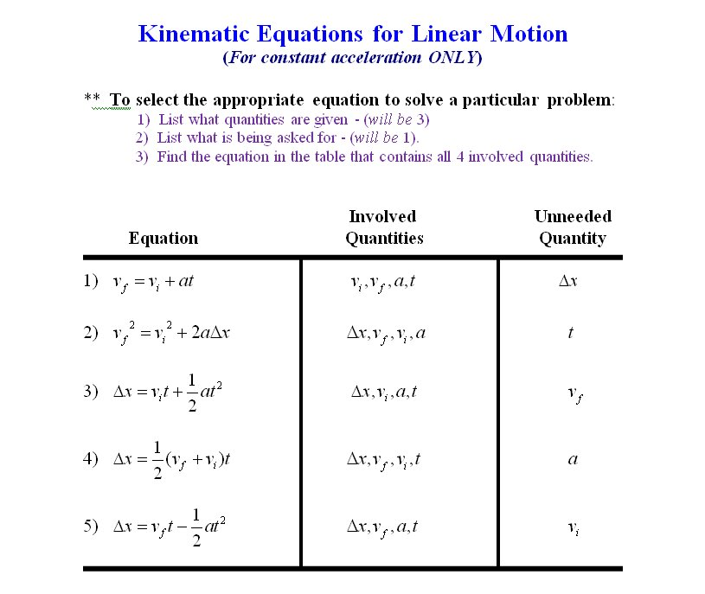

Slide 5
After Working a Problem…
Are my units ok?
Is my magnitude reasonable?
Is my direction reasonable?

Slide 6
Using our new kinematic (motion) models, we can answer our original question:
A car, starting at rest, experiences a constant acceleration of 5 m/s² for 10 sec.
    How far has the car traveled?

Slide 8
Question
A driver traveling at a constant 112.6 km/hr (70 mph) drops his favorite CD on the floorboard. He takes his eyes off the road for 3 sec to retrieve it.
    How far does he travel (in m) while not paying attention to the road?

Slide 10
Question
Spotting a state trooper on your way home for Thanksgiving break, you casually reduce your speed from 38 m/s (85 mph) to 31.3 m/s (70 mph) in 4 sec.
    What is your acceleration?
    How far did you travel while you were breaking?

Slide 12
Question
While rock climbing, you look down to monitor your progress when your favorite pair of sunglasses fall off. You observe (in the midst of your sorrow) that they are accelerating away from you at a constant rate of 9.8 m/s² as they plummet toward the ground.
    If it takes 5 sec to reach the ground, how high are you on the cliff?
    What is the speed of the sunglasses just before shattering on the ground below?

Slide 14

What is the acceleration of the car (in mph/s)?

